Slide 1
Data Science-Final Project Bone X-Ray Detection
Made By-
You Fu-001497262
Supriya Murty-001431577
Aravind Mandapaka-001277353
Weikai Chen – 001499376

Slide 2
Problem Description!
Musculoskeletal conditions affect more than 1.7 billion people worldwide, and are the most common cause of severe, long-term pain and disability.
MURA (musculoskeletal radiographs) is a large dataset of bone X-rays.
The data set comprises of 40,561 images from 14,863 studies, where each study is manually labeled by radiologists as either normal or abnormal.
Each study belongs to one of seven standard upper extremity radiographic study types: elbow, finger, forearm, hand, humerus, shoulder and wrist
Determining whether a radiographic study is normal or abnormal is a critical radiological task: a study interpreted as normal rules out disease and can eliminate the need for patients to undergo further diagnostic procedures or interventions.

Slide 3
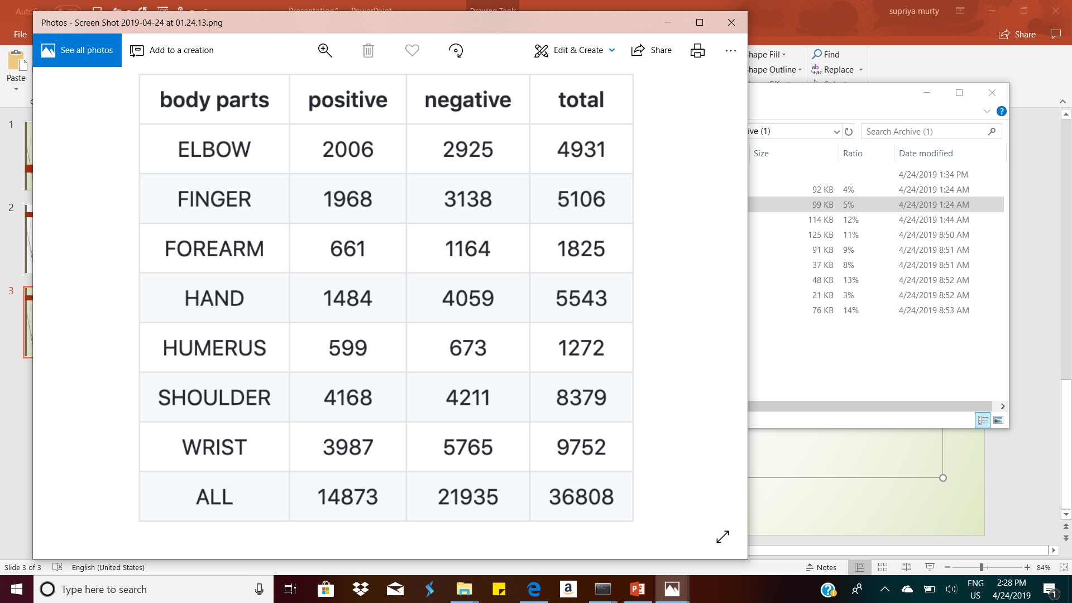
Train-Image Dataset
Train the CNN model

Slide 4
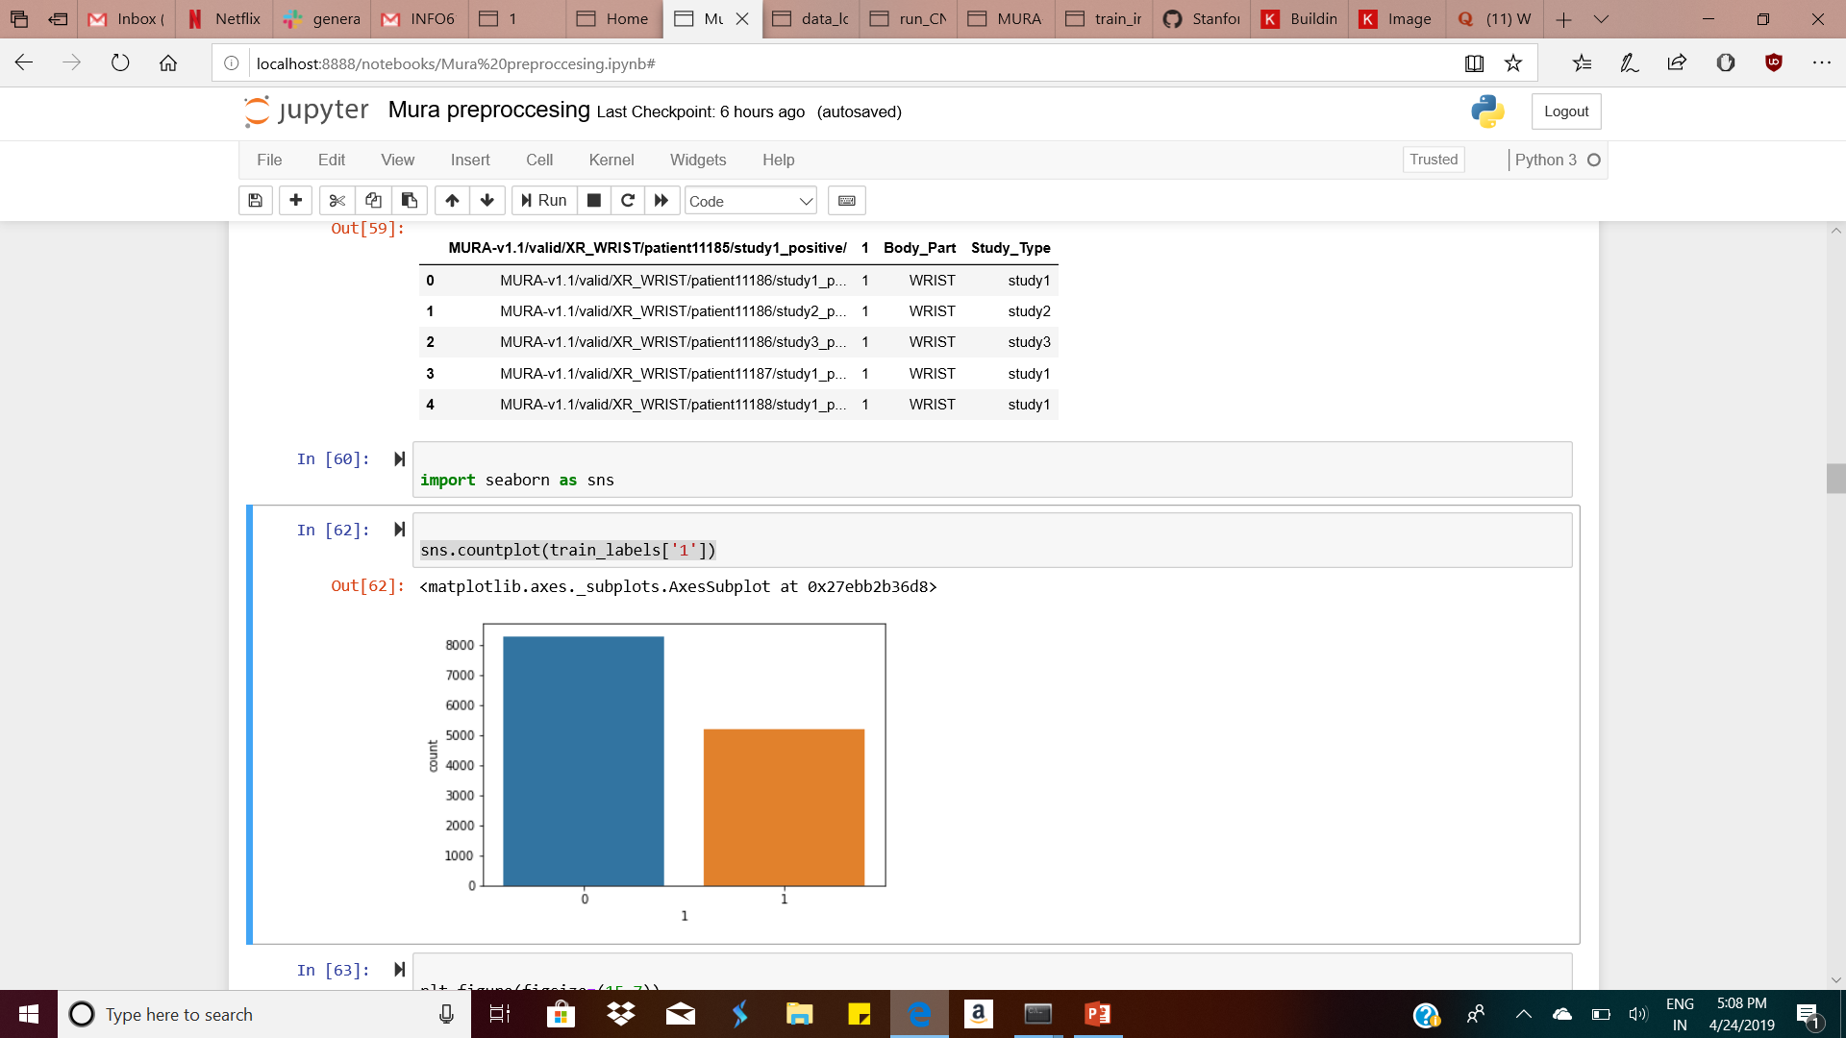
Train Dataset
sns.countplot(train_labels['1’])

Slide 5
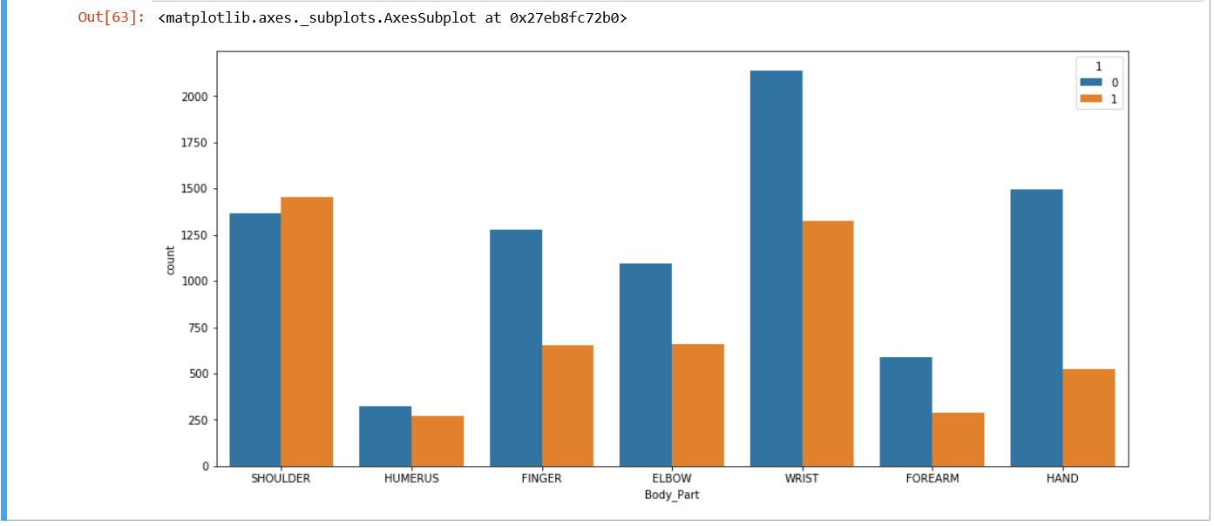
Graphical Representation

Slide 6
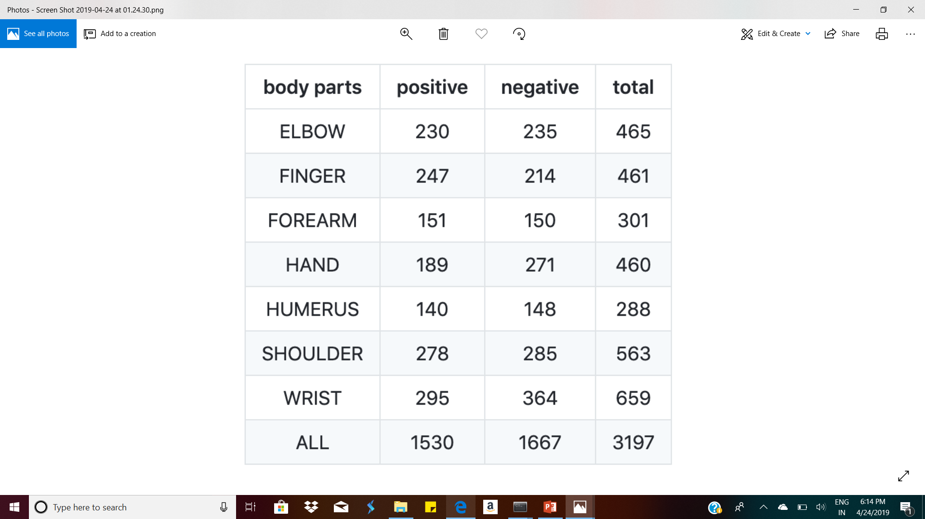
Test Data

Slide 7
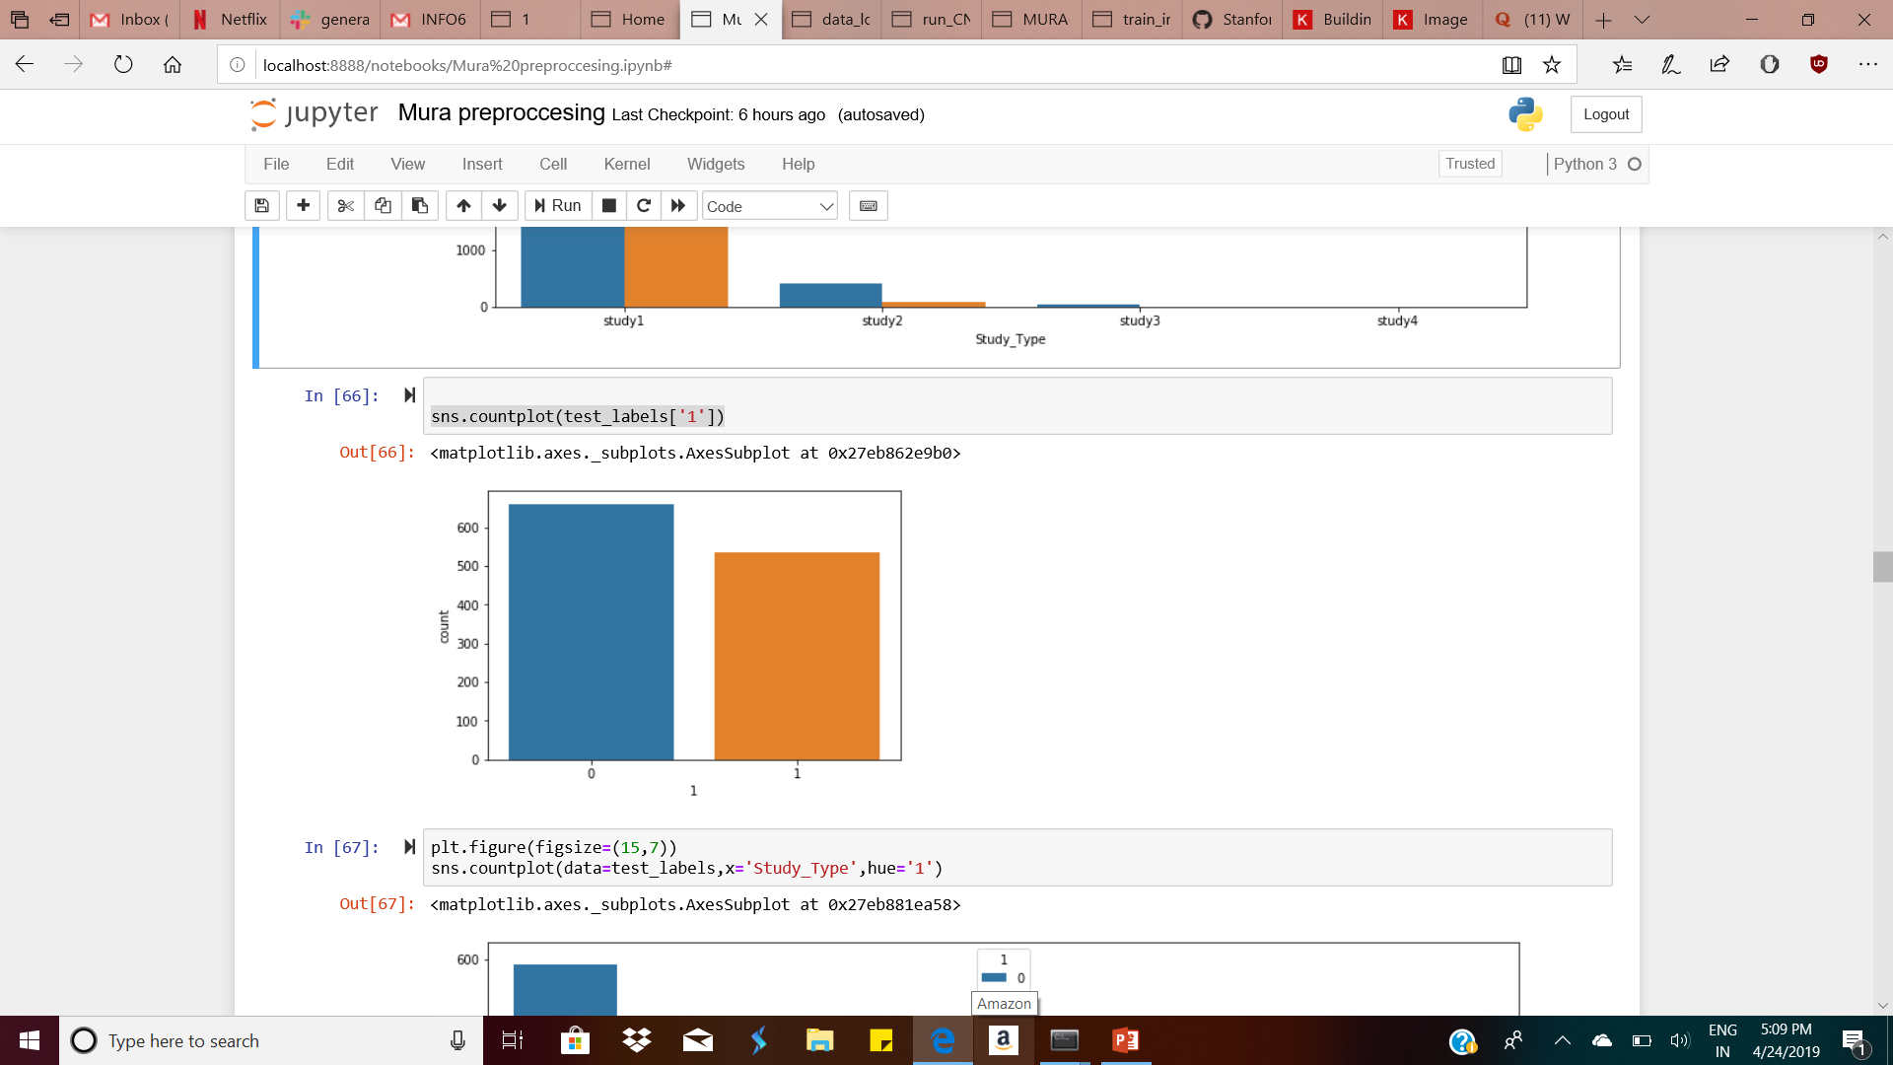
Test Dataset
sns.countplot(test_labels['1’])

Slide 8
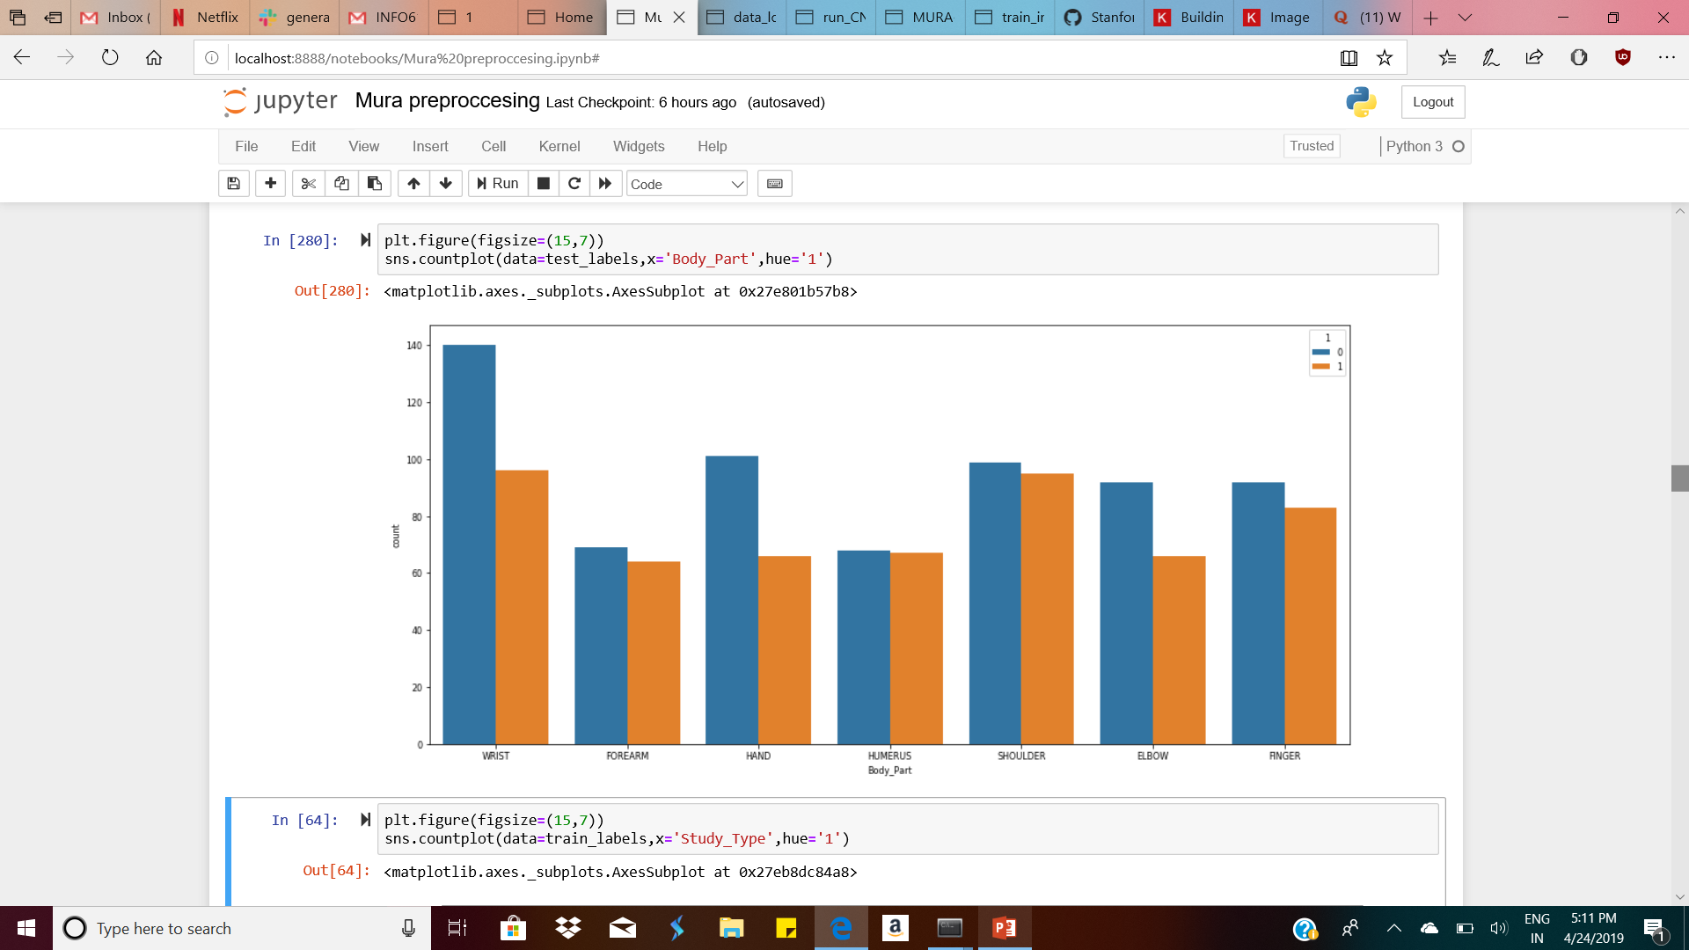
Test Dataset
predict the CNN model

Slide 9
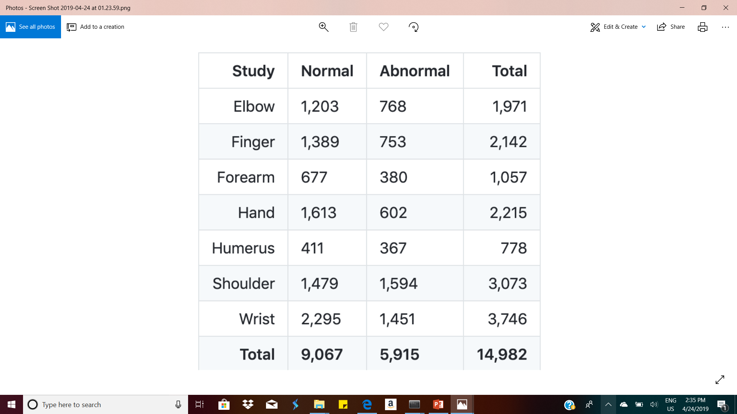
Valid Dataset
fix the CNN model as validation data

Slide 10
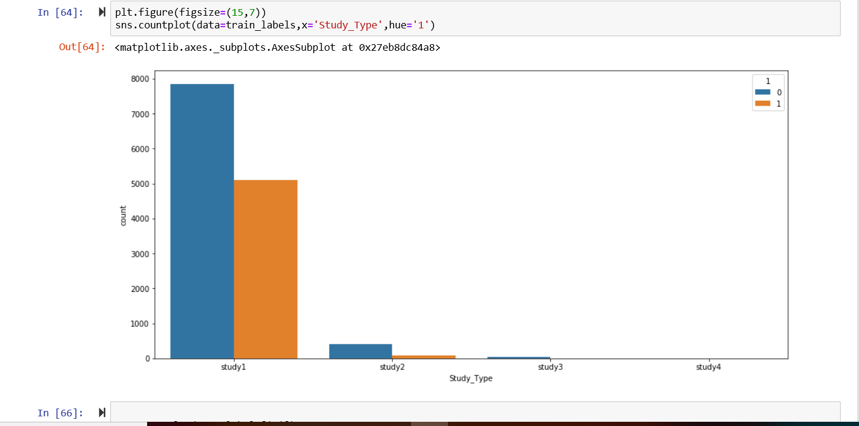
Graphical Representation- Study Type

Slide 11
Data Preparation-Image Preprocessing
Data_loader.py
We used ”from keras.preprocessing.image import ImageDataGenerator” library to perform image preprocessing
Image preprocessing was required to analysize the x-ray from different views.
To improve the image data (features) by suppressing unwanted distortions
To enhance of some important image features.
Lastly preprocessing is used to conduct steps that will reduce the complexity and increase the accuracy of the applied algorithm.

Slide 12
Continued..
We basically perform 4 techniques to perform image preprocessing.
Read image- def load_path(root_path, size):
'''load MURA data ‘‘’
2.Load image- def load_image(path, size):
'''load MURA data ‘‘’
3. Resize image- To make the size of all the images same we performed image resize.(224*224)
4. Normalization- To bring the range of Image intensity values to a normal distribution.
5. Rotation: Rotated the image in the angles of 30, 45, 60 degrees to get the best view.
6.Flipping: Performed Horizontal and vertical flipping.
7. Shear and Zoom Range: To check the Shear Intensity and zoomed picture of the x-ray image

Slide 13
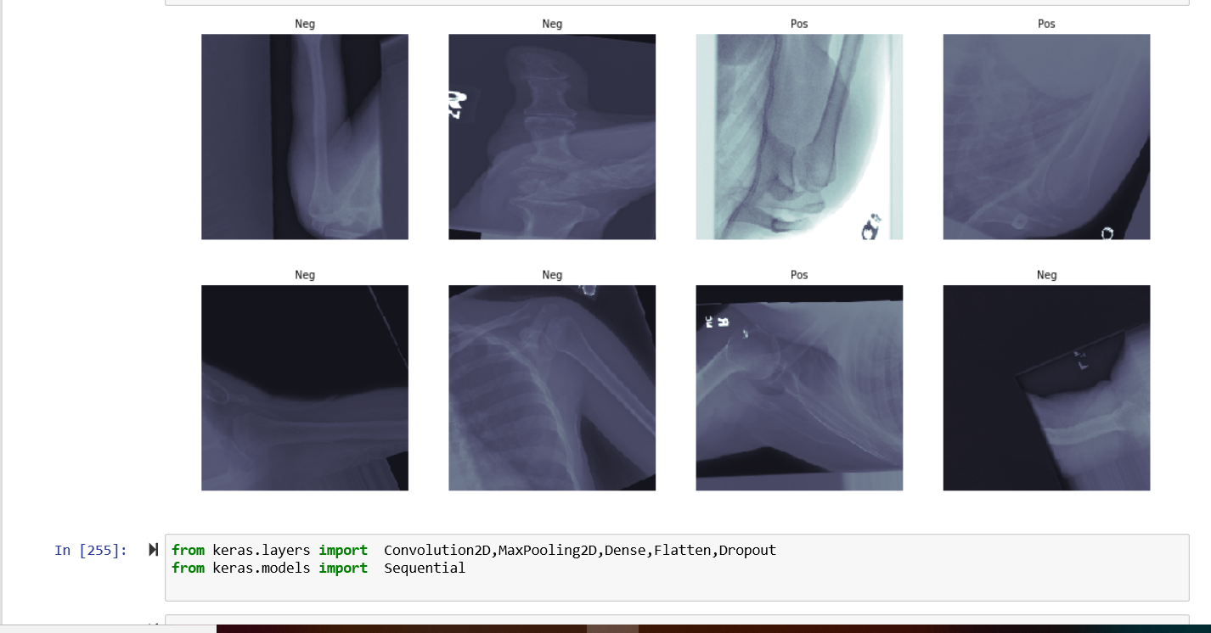
After Image Preprocessing

Slide 14
CNN Model
Build model
We used these libraries to build our CNN Model “from keras.layers import Convolution2D,MaxPooling2D,Dense,Flatten,Dropout”
“from keras.models import Sequential”
For creating the model we used
batch_size = 128, nb_classes = 10, epochs = 3
The number of convolution filters we used- nb_filters = 64
The size of pooling area for max pooling- pool_size = (3, 3)
The convolution kernel size- kernel_size = (3, 3)

Slide 15
Continued..
We used 4 convolution layers to get the final model with each layer acting as the input to the next layer.
model.add(Convolution2D(nb_filters, (kernel_size[0], kernel_size[1]),
padding='same',
input_shape=img_dim)) # Convolution layer 1
model.add(Activation('relu')) # Activation layer
model.add(Convolution2D(nb_filters, (kernel_size[0], kernel_size[1]))) # Convolution layer 2
model.add(Activation('relu')) # Activation layer
model.add(MaxPooling2D(pool_size=pool_size)) # Pooling layer
model.add(Convolution2D(nb_filters, (kernel_size[0], kernel_size[1]))) # Convolution layer 3
model.add(Activation('relu')) # Activation layer
model.add(MaxPooling2D(pool_size=pool_size)) # Pooling layer
model.add(Convolution2D(nb_filters, (kernel_size[0], kernel_size[1]))) # Convolution layer 4
model.add(Activation('relu')) # Activation layer
model.add(MaxPooling2D(pool_size=pool_size)) # Pooling layer

Slide 16
Parameters
We used the following parameters :
Dropout- Random inactivation of neurons
Flatten-This converts our 3D feature maps to 1D feature vectors
Dense-Provides a fully connected layer.
Activation(relu)

Slide 17
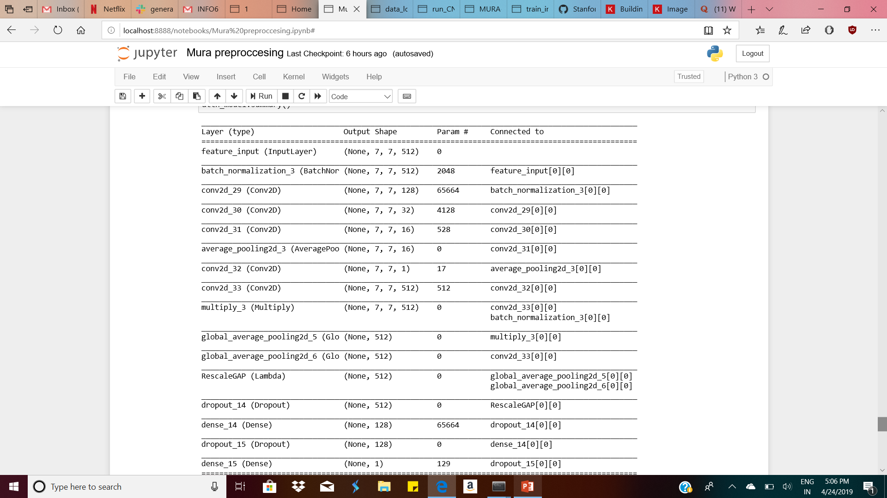
Continued..

Slide 18
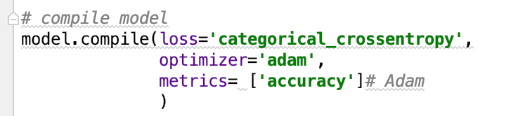
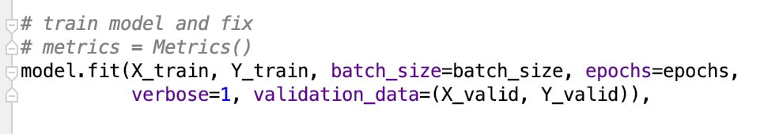
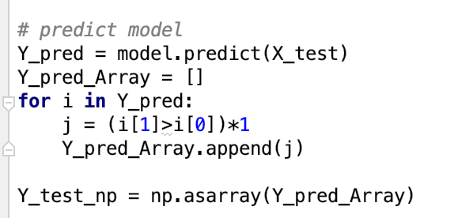
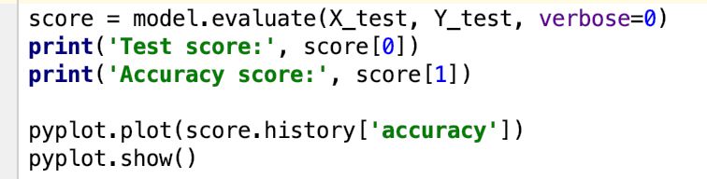
Continued..
Compile model
Fix model
Train model
Predict model
Evaluate model

Slide 19
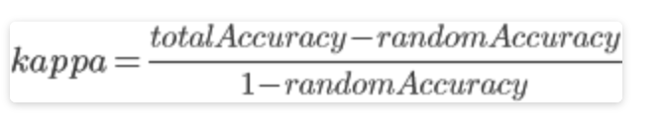

Kappa Score
Cohen's kappa coefficient (κ) is a statistic which measures inter-rater agreement for qualitative (categorical) items. It is generally thought to be a more robust measure than simple percent agreement calculation, as κ takes into account the possibility of the agreement occurring by chance

Slide 20
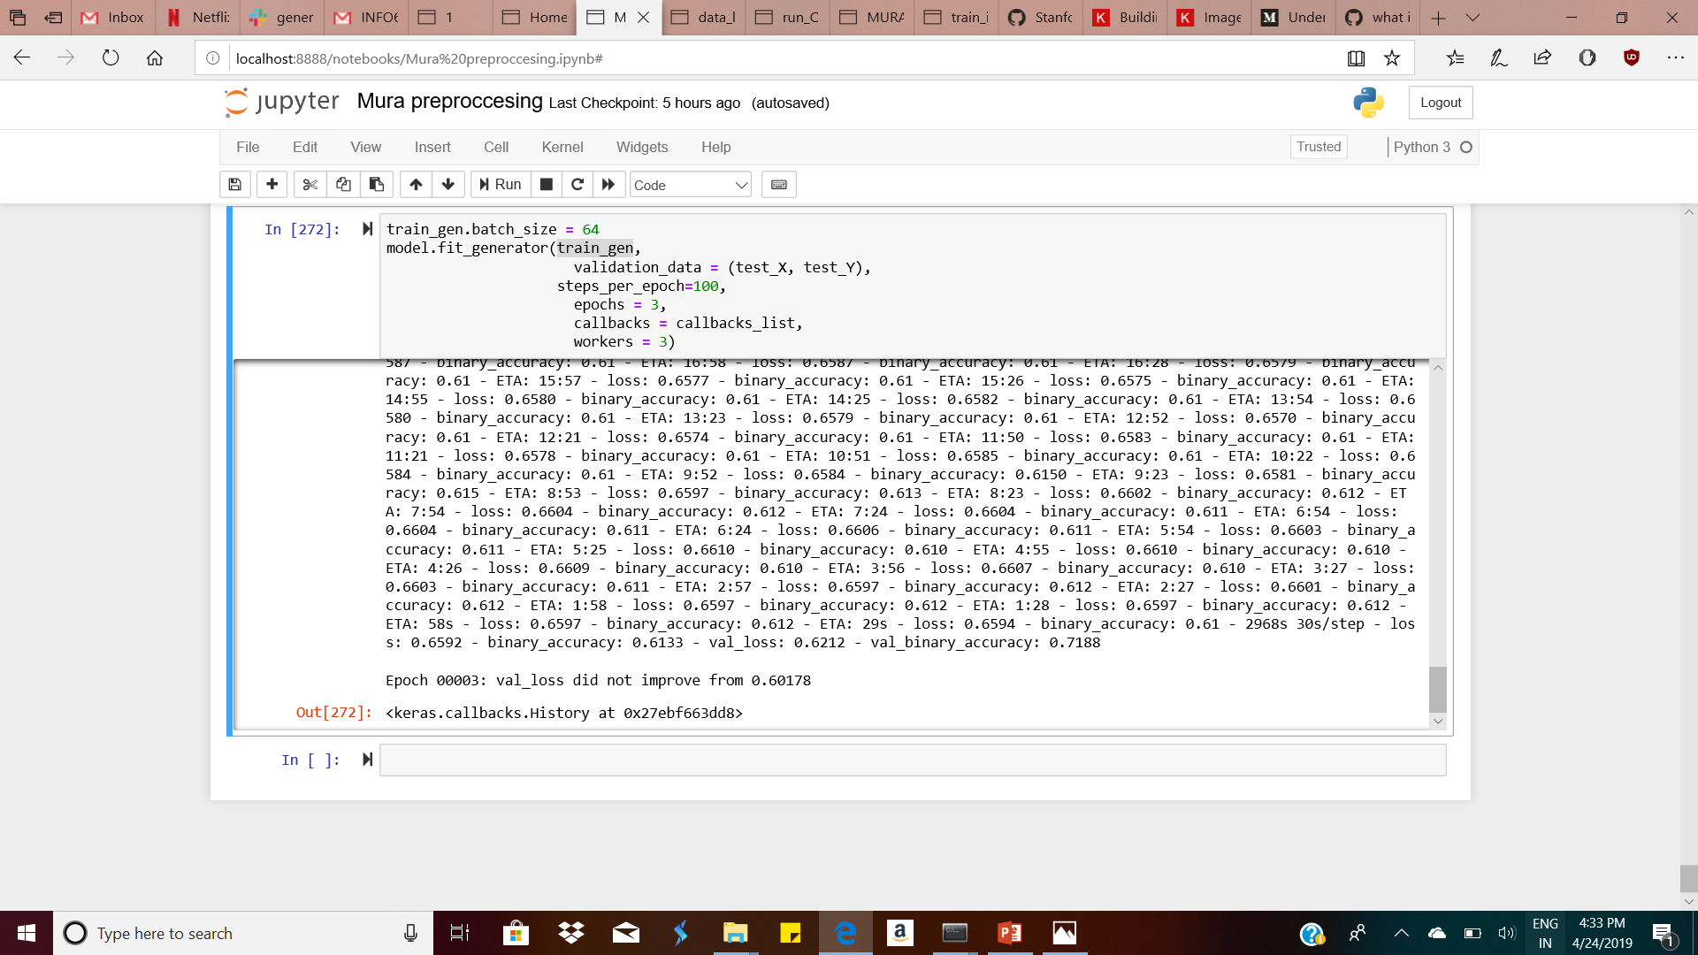
Results
The final result that we got is:
Total Layers
Accuracy of almost 60%
Kappa Score- 0.21

Slide 21
Final Conclusion:
The model that was built using 4 convolution layers is the preferred model instead of 3 where we got an accuracy of 60%.
Also the parameters that we finalized were:
Global Average Pooling
Flatten
Dense
Dropout
Batch Normalization
The performance of the model is evaluated through accuracy and kappa score.

